Slide 1
A Digital Fingerprint By Stephen Santise Advisor Prof. Aaron G. Cass

Slide 2
The Plan
The Goal
To be able to accurately identify a user based solely off their browsing history.
To utilize previously recorded browsing history to train a classifier to identify the user who created the new history
Notes:
The Goal, The Plan, The Reason (story) prob next slide

Slide 3
The Motivation.
Notes:
Imagine that one day when closing down pasta lab you realize that someone left a laptop behind and there is nothing on the laptop with the owners name. But the screen is still open to firefox so you want to use this to help figure out who the laptop belongs to. Now for the last couple of years the cs dept has been keeping tabs on all of their students and has been recording their browsing histories. Unfortunately the dept realized early this year that by recording this history they may be in violation of the 4th amendment and stopped. This is where my research will come in.

Slide 4
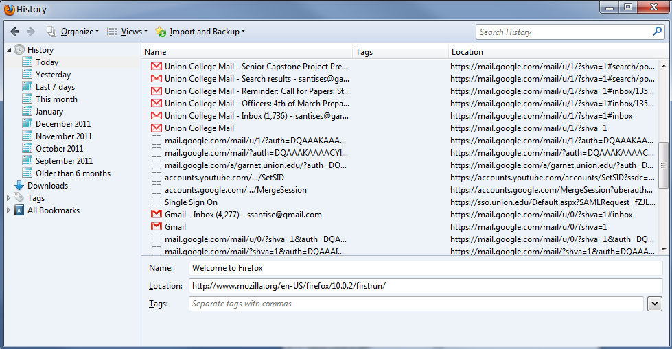
Each History is Unique
Notes:
Every time that a webpage is visited its saved to your browser history depending on your browser it comes in a different type of database file. This file contains a great deal of extra data. For the purpose of this research I will be striping out this data and dealing with just an ordered list of wepages visited.

Slide 5
What Makes Each History Unique?
The websites that have been visited
The number of times each website has been revisited
The order in which each website has been visited
Notes:
Explain here why order is important. Both may visit the same page but not the same combination of pages

Slide 6
Representing Multiple Users Histories as a Dataset
Last Column is
usually the “Class”
or “Target”
Columns are “Attributes”
or “Predictors”
Rows are
“Instances”
Attribute Values can be
Nominal or Numerical
Notes:
Just explain whats here

Slide 7
Using the dataset to represent the history’s uniqueness
Every webpage visited already represented
To Represent revisiting a website
Notes:
Explain difference between website and webpage in context of revisiting the same page

Slide 8
Representing Order within the Dataset
Use N-grams
Tri-gram: [Site9, Site10, Site11]
1skip Bi-gram: [Site9, Site11]
Notes:
Don’t forget to explain that N-grams originally comes from text classification

Slide 9
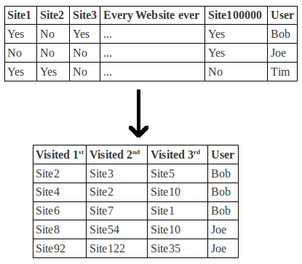
How N-grams change the Dataset
Notes:
Explain low difference amongst websites introduce how things people do everyday in order. Then effect on dataset which will be recognize by classifiers

Slide 10
Using the Created Datasets
After researching different techniques I found that learning classifiers were best suited for this task of identification for four main reasons:
They use simple datasets that can be easily manipulated
Classification is a similar task to identification
A great deal of classifier algorithms have already been developed and are readily available to be used through the Weka library.
Tools are readily available to evaluate the correctness of a classifier’s results on classifying a dataset
Notes:
Basically explain why were using classifiers

Slide 11
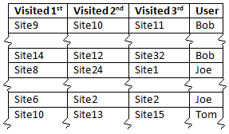
The Difference Between Classification and Identification
Classification
Identification
Whichever user is predicted most
Training set
Test Set
Predicted Value
Notes:
Also explain how evaluation of the classifier will be done on this page

Slide 12
Experiment
Collect browsing histories from volunteers.
Strip the extra data out of the collected browsing histories
Create data sets. Which includes:
A separate dataset for every combination of n-grams and skips from a 0 skip bi-gram to a 50 skip 50-gram
One of every previous dataset for both website and webpage specificity
Then splitting every users dataset into two sets.
80% training set
20% testing set
Notes:
Just go through the steps

Slide 13
Experiment
For every dataset train a classifier and test it with its corresponding test set.
Evaluate the results to find which representation of the data will yield most correct user identifications.
Ideally it will correctly identify every user
Report on the findings
Currently I am on step 4. I have created every necessary training and test set and have begun to use the Naïve Bayes Classifier to produce results.
Notes:
Continue going through the steps

Slide 14
Future Work
If this research finds an ideal dataset representation for browsing histories it will open the door to a variety of different implementations.
You could imagine smarter websites that know who you are without ever having to tell them
The government could use this as a unique way to track criminals
This research could be expanded to identify different types or groups of people to aid online recommendation systems
Could be used to match similar people in a dating environment
Notes:
Summarize what we got here

